Slide 1
BJA Coronavirus Emergency Supplemental Funding (CESF)
April 1, 2020

Slide 2
Overview
The Bureau of Justice Assistance (BJA) has now posted a solicitation for state, local and tribal applicants for CESF funding – link here:
https://bja.ojp.gov/sites/g/files/xyckuh186/files/media/document/bja-2020-18553.pdf
The CESF Program will provide funding to assist eligible states, local units of government, and tribes in preventing, preparing for, and responding to the coronavirus.

Slide 3
Timeline
The project period will be established retroactively to January 20, 2020, but please note that federal supplanting rules apply
The project period for this grant is 24 months, with an opportunity for a 12-month extension.
The grant application must be submitted via OJP’s Grants Management System (GMS). Application Deadline: 11:59 p.m. eastern time on May 29, 2020

Slide 4
How Funds are Distributed
This grant is modeled on the 2019 JAG grant, so any recipients from that grant should be eligible applicants for this supplemental funding.
State allocations vs direct awards
https://bja.ojp.gov/program/fy20-cesf-allocations

Slide 5
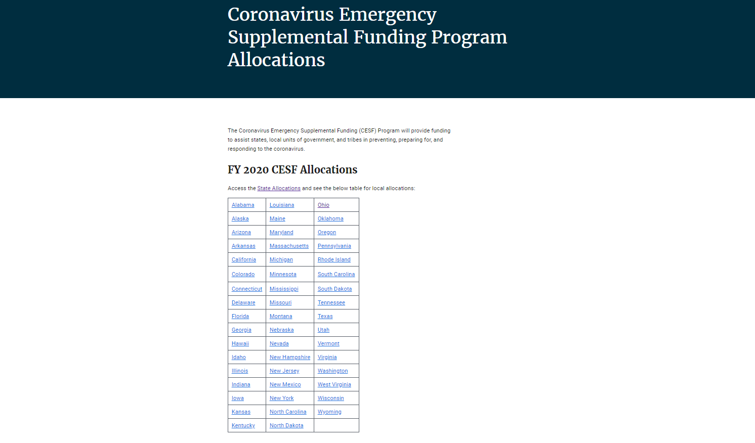

Slide 8
How Funds are Distributed
Maximum number of awards that BJA intends to make: 1873
Grant recipients may draw down funds in advance, or on a reimbursement basis. No match required.

Slide 9
Eligibility
States, U.S. Territories, the District of Columbia, units of local government, and federally recognized tribal governments.
The term “units of local government” includes a town, township, village, parish, city, county, borough, or other general-purpose political subdivision of a state, or a federally recognized Indian tribal government that performs law enforcement functions.

Slide 10
Definition
A unit of local government also may be any law enforcement district or judicial enforcement district established under applicable state law with authority to independently establish a budget and impose taxes; for example, in Louisiana, a unit of local government means a district attorney or parish sheriff.

Slide 11
Drawdown of Funds
Consistent with the CESF Program’s purposes, State Administering Agencies or units of local government may draw down funds either in advance or on a reimbursable basis.
To draw down in advance, funds must be placed in an interest-bearing dedicated CESF account and other awards or sources may not be commingled with CEFS funds.
Limitation on direct administrative costs – Funds may not be used for direct administrative costs that exceed 10 percent of the total award amount.

Slide 12
Allowable Costs
Allowable projects and purchases include, but are not limited to, overtime, equipment (including law enforcement and medical personal protective equipment), hiring, supplies (such as gloves, masks, sanitizer), training, travel expenses (particularly related to the distribution of resources to the most impacted areas), and addressing the medical needs of inmates in state, local, and tribal prisons, jails, and detention centers.
Other allowable Criminal Justice Expenses

Slide 13
What an Application Should Include
Application for Federal Assistance (SF-424)
Intergovernmental Review
Program Narrative
Budget Detail Worksheet
Budget Narrative
Indirect Cost Rate Agreement (if applicable)
Financial Management and System of Internal Controls Questionnaire
Disclosure of Lobbying Activities (SF-LLL)

Slide 14
Application cont.
Applicants must submit a program narrative, budget and budget narrative, but BJA/OJP will expedite the review of these applications and move them as quickly as possible to award.
For additional information, see the “How to Apply (GMS)” section in the OJP Grant Application Resource Guide.
https://www.ojp.gov/funding/apply/ojp-grant-application-resource-guide#howToApplyGMS

Slide 15
Coronavirus Emergency Supplemental Funding (CESF)
Questions

